Slide 1
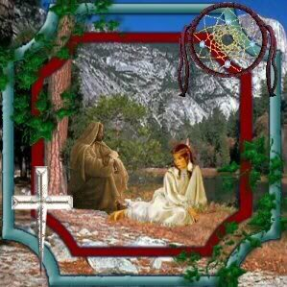
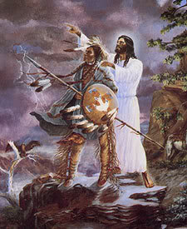
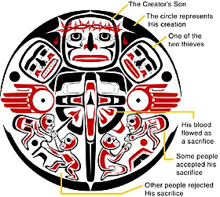
Missions to Native Americans
Aaron, Adam, Rick, Sam, Stephanie, & Zach

Slide 2
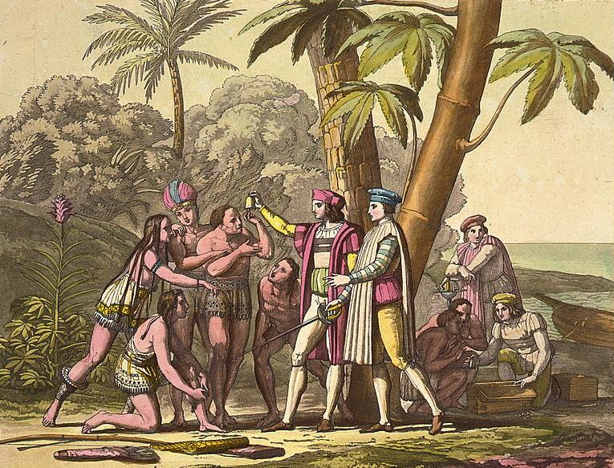
“How Indian Conversion to our Holy Faith might be undertaken.” – Christopher Columbus
Notes:
Intro-SAM

Slide 3
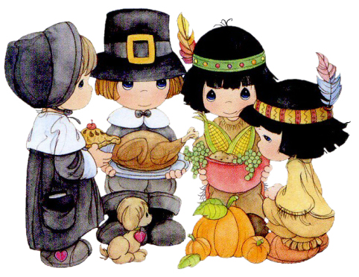
Notes:
Intro-SAM

Slide 4
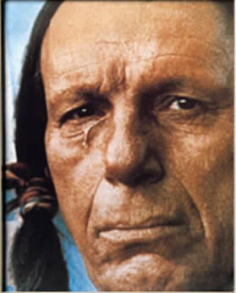
Downer :(
Notes:
final slide for intro-SAM

Slide 5
Captivity Narratives

Slide 6
Historical Background/ Considerations
King Philip’s War (1676)
Deteriorating Conditions in Europe
French Indian War (1754)

Slide 7
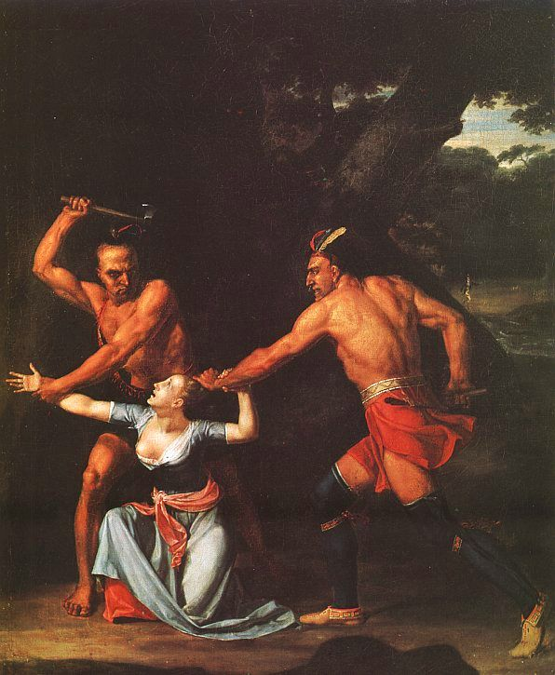
Mary Rowlandson
Background/family
Summary of her narrative

Slide 8
Affect of Narratives on Anglo-American Identity

Slide 9
Lasting Perceptions of Captivity Narratives

Slide 10
Manifest Destiny

Slide 12
Richard Twiss on Manifest Destiny

Slide 13
Trail of Tears

Slide 14
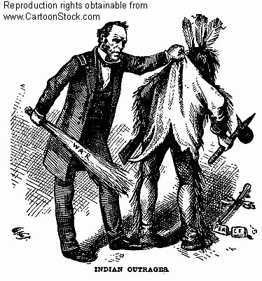
Indian Removal Act
Notes:
Indian Removal 1st slide-SAM

Slide 15
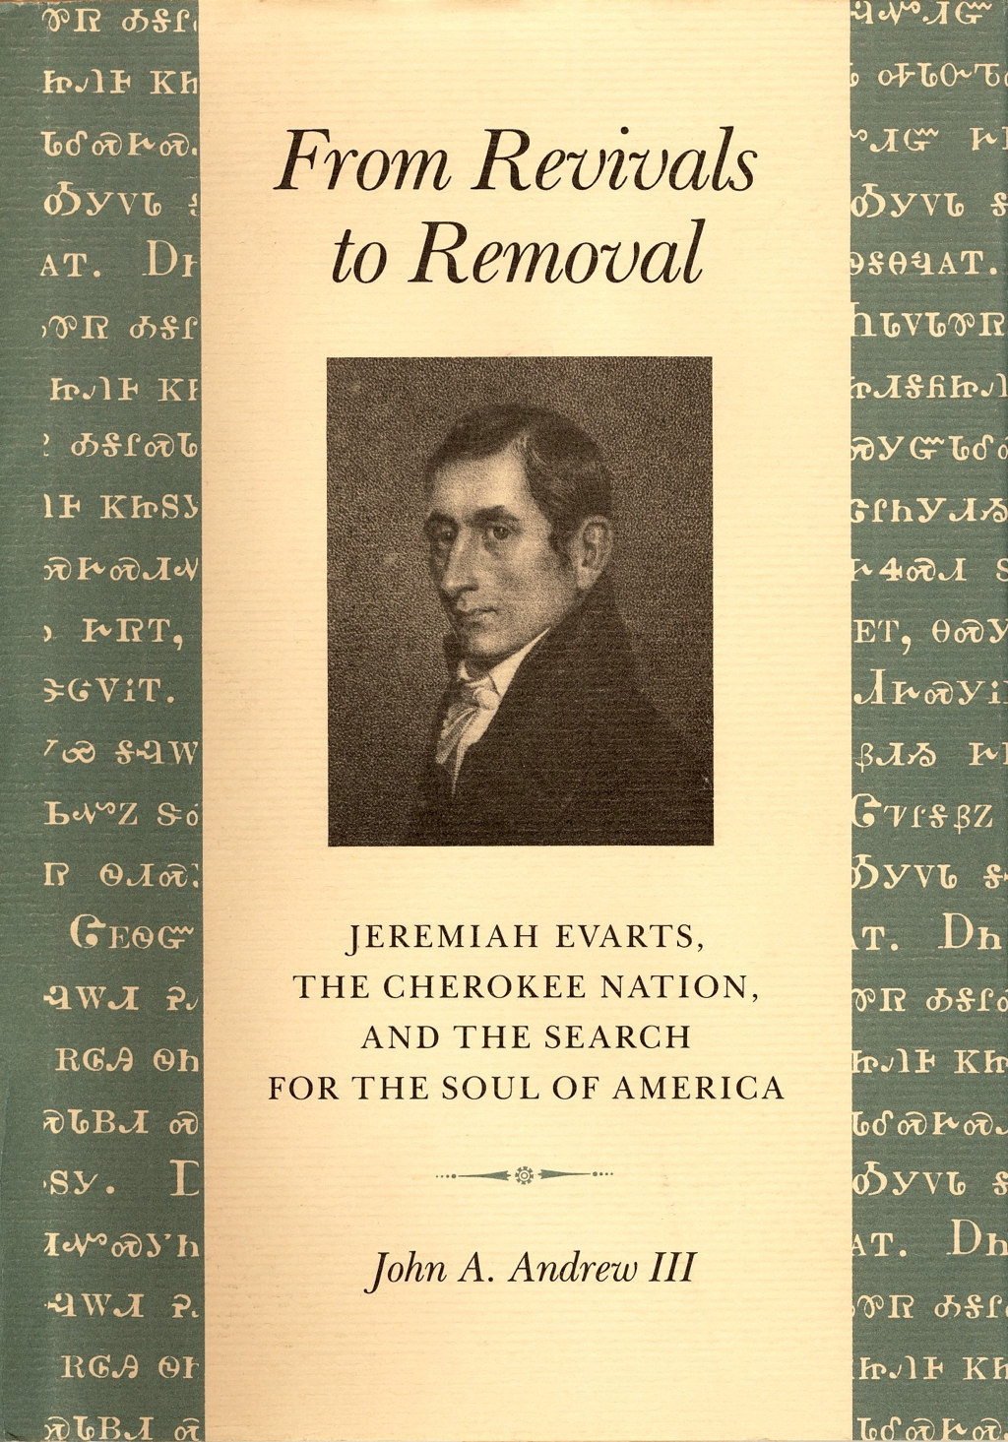
Notes:
Indian Removal final slide-SAM

Slide 16
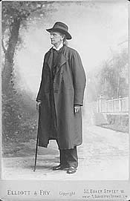
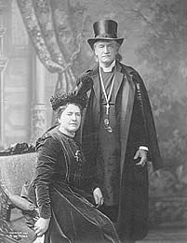
Henry Benjamin Whipple “Straight Tongue”

Slide 17
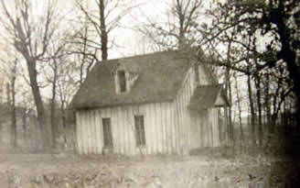
Missions to the Native Americans

Slide 18
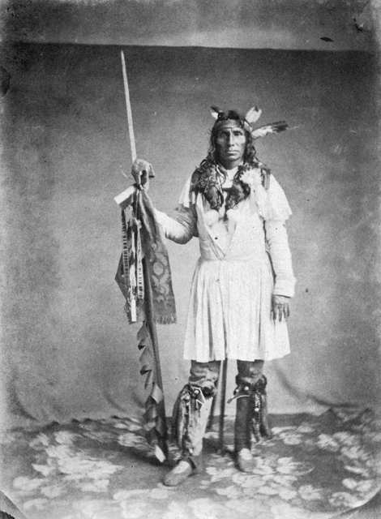
Little Crow’s War Sioux Uprising

Slide 19
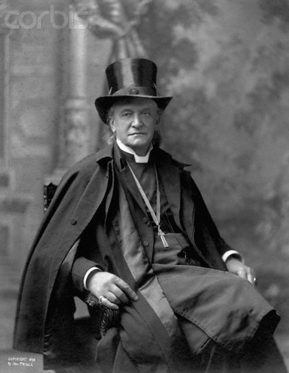

Slide 21
Missionary Attitudes in Alaska

Slide 22
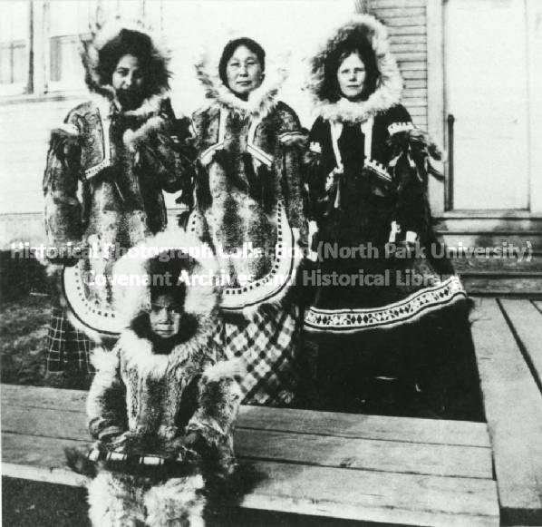
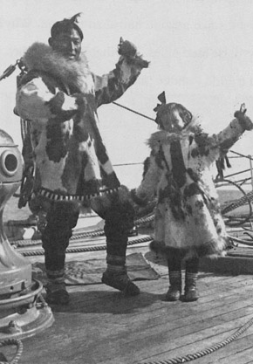
Christianity and Eskimo Culture

Slide 23
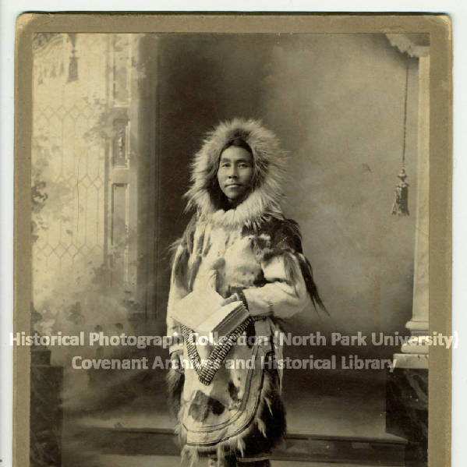
Alaska Native Church Leaders

Slide 24
A Native American Theology Clara Sue Kidwell, Homer Noley, George “Tink” Tinker Purpose
“[To] encourage a creative, new visioning process for Native people where they can recognize the uniqueness of their practices with regard to Christianity.” p 1
“We envision renewed health for Indian cultures and each Indian national community.” p 1

Slide 25
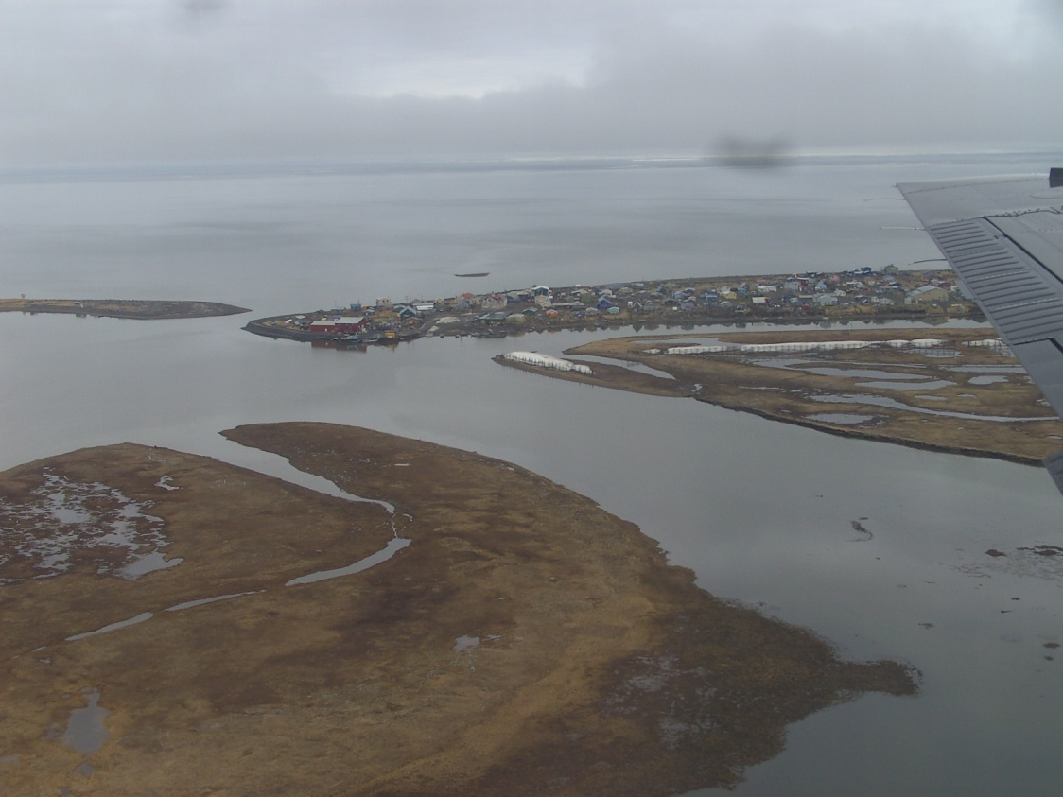
“Broken Walls”
Lead Singer: Mohawk worship leader, Jonathan Maracle
“River of Life”

Slide 26
Native Religious Characteristics
Religious experiences in dreams and visions
Words have creative power
Personal relationship between the individual and the spiritual world that manifests itself in the physical world p6
Ceremony is a part of day-to-day existence
Whole cultural and social structure was and still is infused with a spirituality that cannot be separated from the rest of the community’s life at any point. p12

Slide 27
Native Theological Categories
Creation: Emphasizes the interconnectedness of all living things
Deity: Primary understanding of a Supreme Being = The Creator, Life-Giver
Christology: Resonates with the Suffering Servant narratives
Theological Anthropology: People share the world with spirits whom they must establish relationships; and experience life as community
Eschatology: Salvation is the continuance of community

Slide 28
Native Christian Expressions
“Some totally reject traditional Indian cultural beliefs, and some integrate Christianity and traditional practices.” p 10
Tribal leaders and members are urging their people to revive traditional ceremonial practices of
Feasting
Dancing
Dreaming

Slide 29
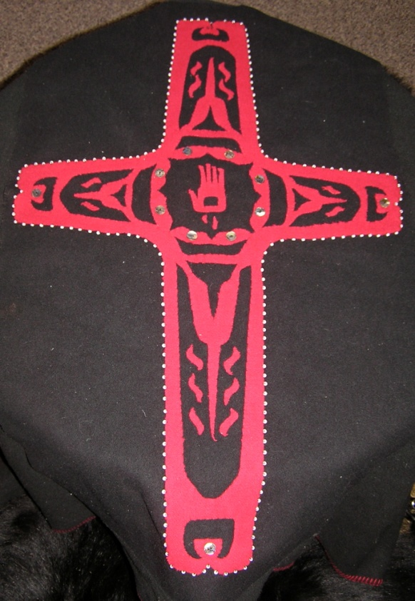
“Broken Walls”
“Khenoronkhwa” (Love/Medicine)

Slide 30
Past to Present
“American Indian communities are still feeling the effects of missionary activities...” p 2
“...the effects of European colonization and the role that Christianity played as a weapon used against Indian cultures.” p 4
“...the highest rates of unemployment, alcoholism, teen-age suicides, school drop-outs, and the lowest rates of longevity, education attained, per capita income, etc.” p 5

Slide 31
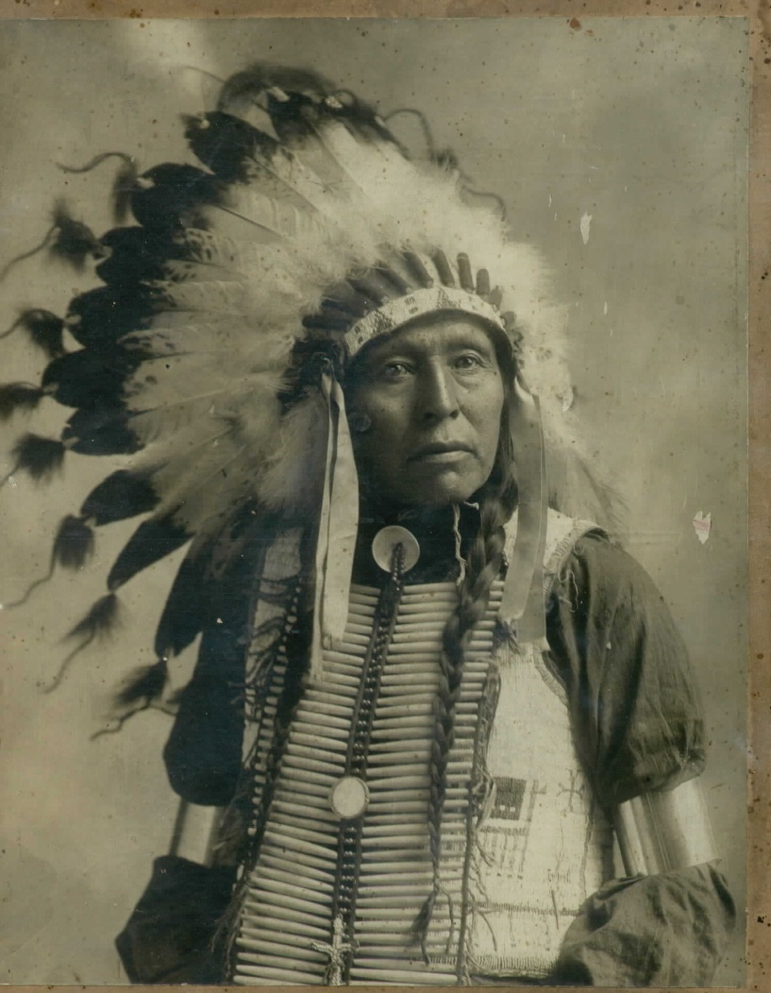
“Broken Walls”
“Warrior”

Slide 32
Concluding Remarks

Slide 33
Richard Twiss – Hope for the Church

